Slide 1
Nutrition in Fast Food
By Ryan Cooper

Slide 2
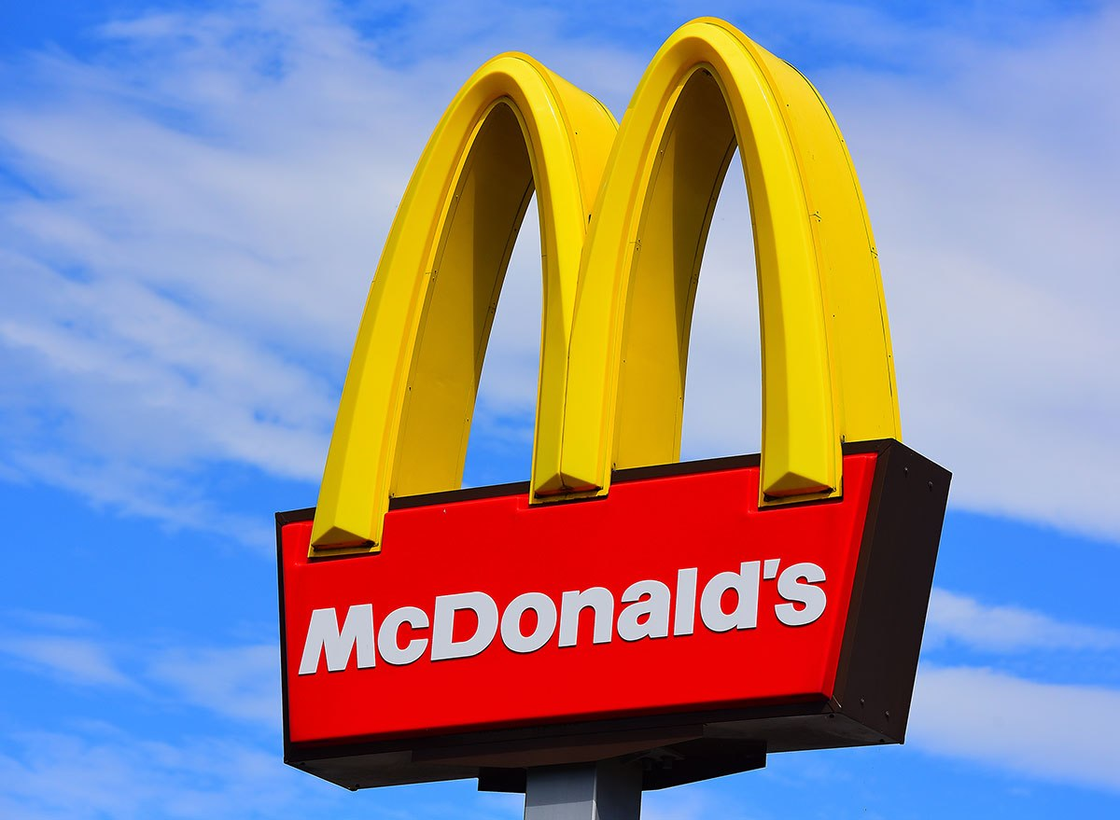
Introduction
Question - How nutritional is food at Fast-Food restaurants?
Purpose - To inform businesses and consumers
Consumers benefit
Fast food companies benefit

Slide 3
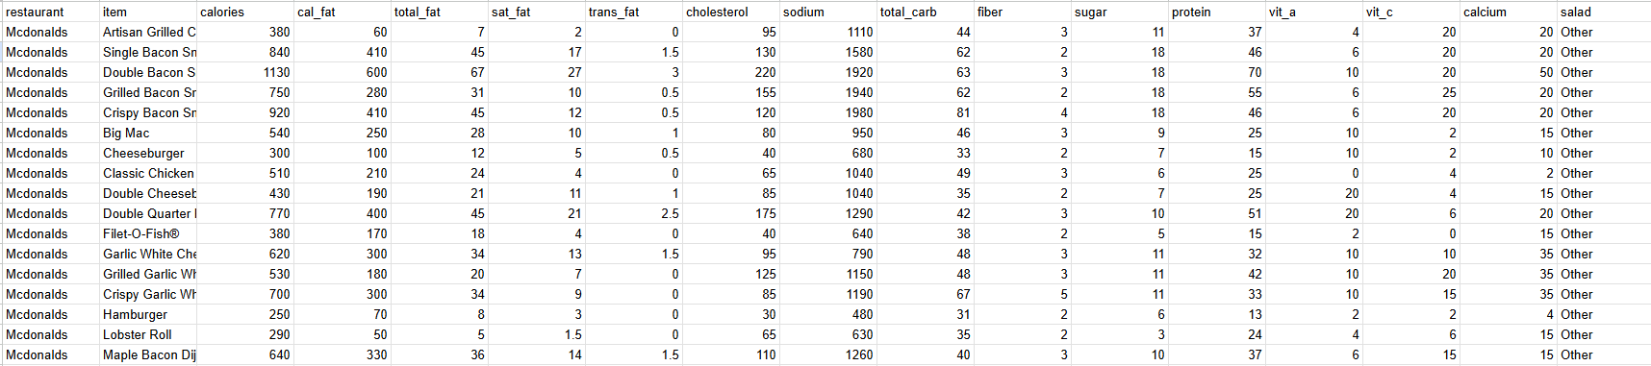
Methodology
I used one dataset from a CSV file on a website named OpenIntro
The individual sample or unit of analysis is a menu item from a fast-food restaurant
Examined multiple nutritional values, such as calories, fat, sodium, carbs, protein, other nutritional components
I used Google Sheets and Jupyter Notebooks

Slide 4
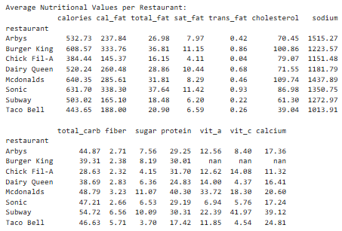
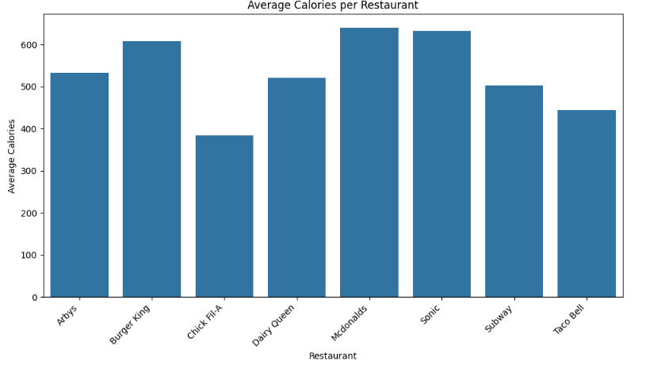
Insight/Results
Analysis lead to more questions after answering

Slide 5
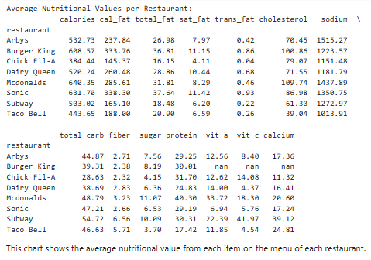
Future Work
Nutrition over time
More fast food restaurants

Slide 6

Extra Information
What is the healthiest burger across all fast food restaurants? (Within the dataset)
Which food has the highest protein-to-calorie ratio?
Food with highest protein-to-calorie ratio: Ultimate Chicken Club, Protein: 39.0, Calories: 100, Restaurant: Sonic, Protein-to-Calorie Ratio: 0.39

